Slide 1
Deep Learning for Grouped Data
Dan Andrei Iliescu
Department of Computer Science and Technology
Notes:
Thank you very much for examining my thesis.
I will take around 15 mins to present the main insights from my PhD
Deep Learning for Grouped Data

Slide 2
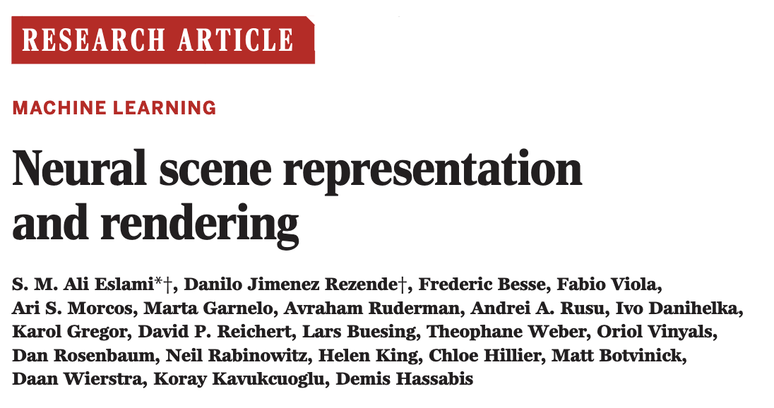
It started in 2018
Notes:
My journey with this topic began in 2018.
I came across a paper from Deep Mind claiming to render 3D scenes from 2D photos.

Slide 3
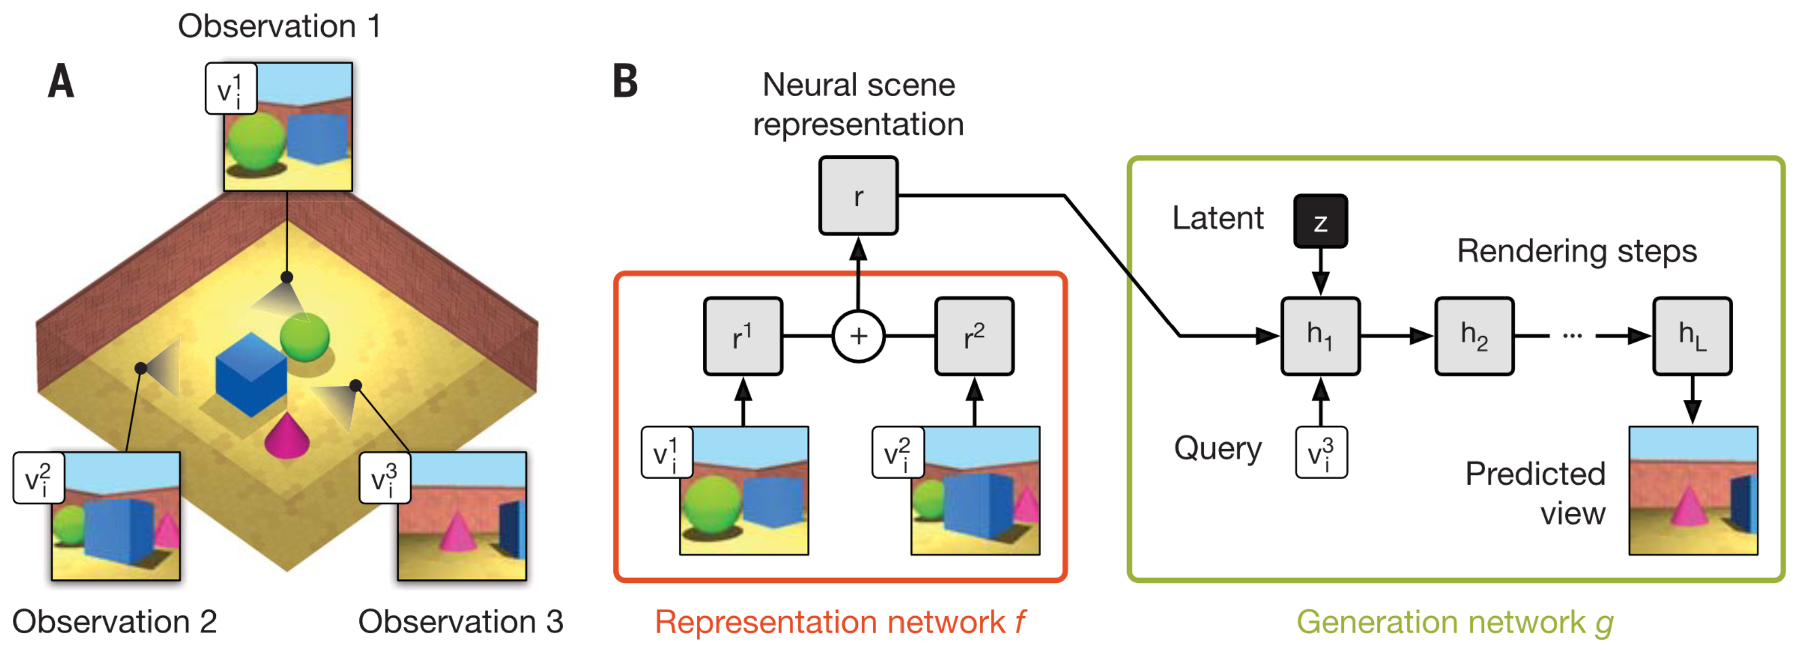
Combining 2D Views Into a 3D Scene
Notes:
This is a figure from their paper.
They used a simulated 3D environment to generate 2D views.
They trained a network to combine the views in order to predict new views.
The network takes as input the group of views and the new viewpoint to generate.

Slide 4
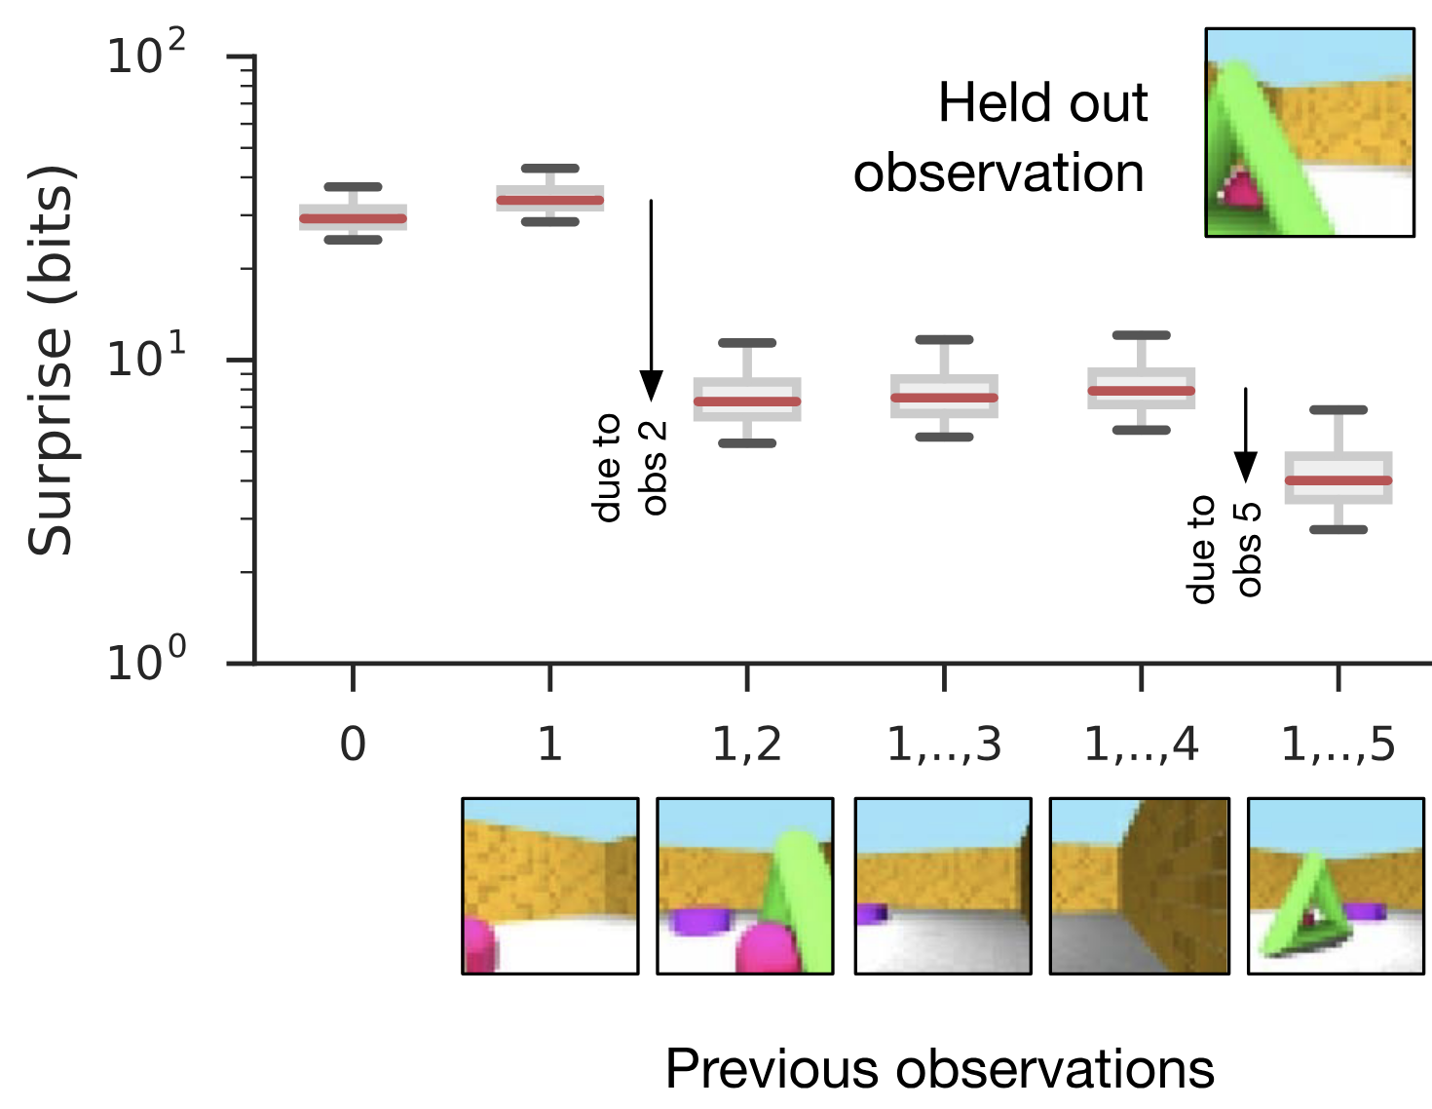
Theoretical Solution: Bayesian Accumulation
Notes:
Theoretically, there is a straightforward solution to this problem: Bayesian Accumulation.
This means a succession of Bayesian updates over each observation in the group.
This is a figure from the paper depicting the improvement in predicting the held-out observation after including each observation in the group.
Notice how including observations depicting the green triangle leads to big improvements.

Slide 5
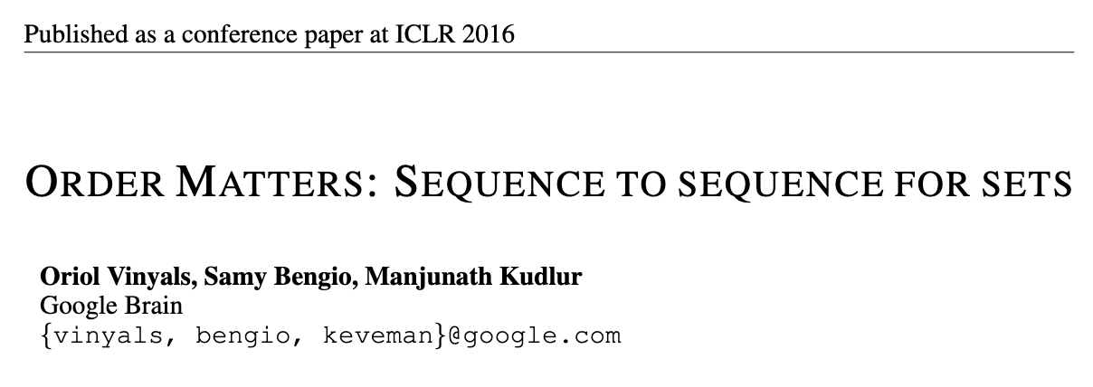
However…
“We do not know how to organize inputs when they correspond to random variables and the task is to model their unknown joint probability.”
Notes:
However, Bayesian accumulation is not straightforward to implement with deep learning. There are multiple challenges.
For example, if the network is an RNN or a Transformer, in what order do you feed the observations?
This is a paper that shows the the order of the inputs has a massive impact on the final output.

Slide 6
My PhD
How can we implement Bayesian accumulation using deep learning?
More precisely:
How can we train a Neural Network to learn a joint distribution over a set of exchangeable variables (i.e., a group)?
The data is high-dimensional.
Notes:
Throughout my PhD I have been attempting to answer this question.

Slide 7
This Presentation
My approach: the Group-Instance Model
Three case studies:
The Initial Problem – Style-Content Disentanglement
A Lateral Move – Missing Data Imputation
The Future – Unsupervised Domain Adaptation
Notes:
You know from my thesis there are 3 case studies. This is how they fit in the story.
In the interest of time we will focus on the third one.

Slide 8
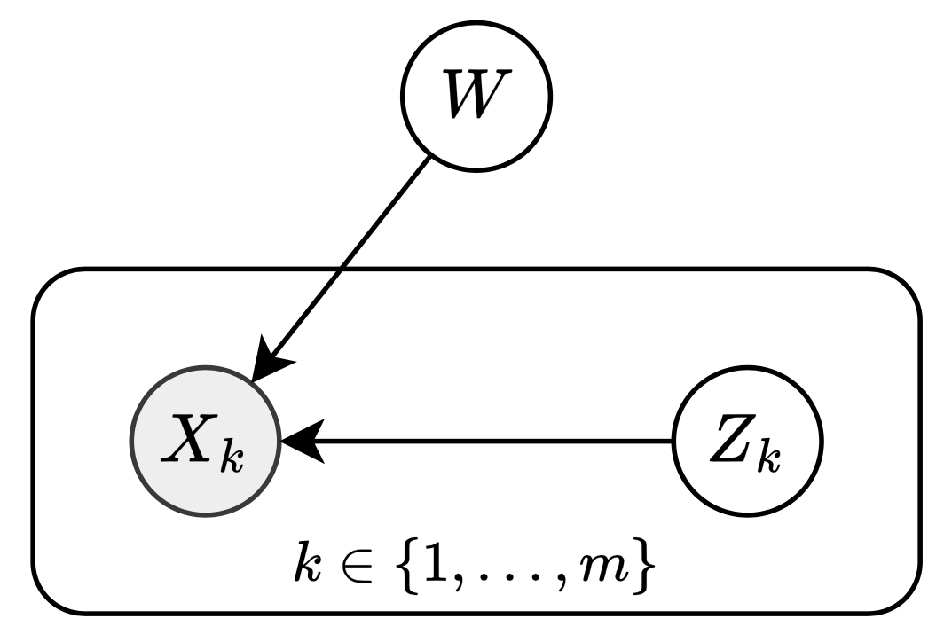
My Approach: The Group-Instance Model
Notes:
My approach is to define a generative model for grouped data: the Group-Instance Model.
We have 3 kinds of variables: observations, group-level latents and instance-level latents.
The group-level latent is the scene.
The instance-level latent is the viewpoint.
The observation is the image.
#
I implement this using a Group Variational Autoencoder that encodes a group of observations into a group-level latent and a group of instance latents.
#
My research goal – my human understandable task
My task – my machine learning task

Slide 9
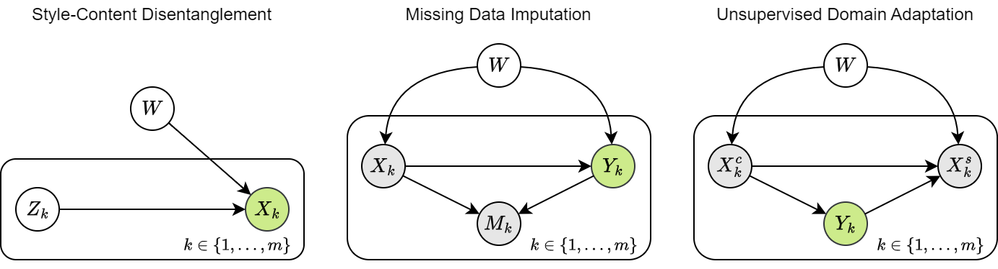
Problems and Insights
1
2
3
A NN can only disentangle if it learns the joint distribution of the instance and group latent variables!
When a NN learns a joint distribution over a group, it will ignore some of the variables!
A NN can outperform causal predictors by conditioning it on the group of observations!
Notes:
The great insight of my PhD is that we can view several real-world, ML tasks as special cases of the Bayesian accumulation framework.
I have tackled three problems using this framework: Style-content disentanglement, Missing data imputation, Unsupervised Domain Adaptation.
Approaching these problems with the Bayesian accumulation framework unlocks other more specific insights.
In the interest of time, I will focus on the application that I find the most exciting, Unsupervised Domain Adaptation.
The insight here is that we can outperform causal predictors by conditioning the predictor on the group of observations.
Grey variables are observed, Green variables are of interest, White variables are latents.

Slide 10
Unsupervised Domain Adaptation
Dan Andrei Iliescu, and Damon J Wischik. “Contextual Predictions: A Bayesian Approach to Domain Adaptation”. Under review for Conference on Causal Learning and Reasoning, 2025
Notes:
This contribution is currently under review for the Conference on Causal Learning and Reasoning

Slide 11
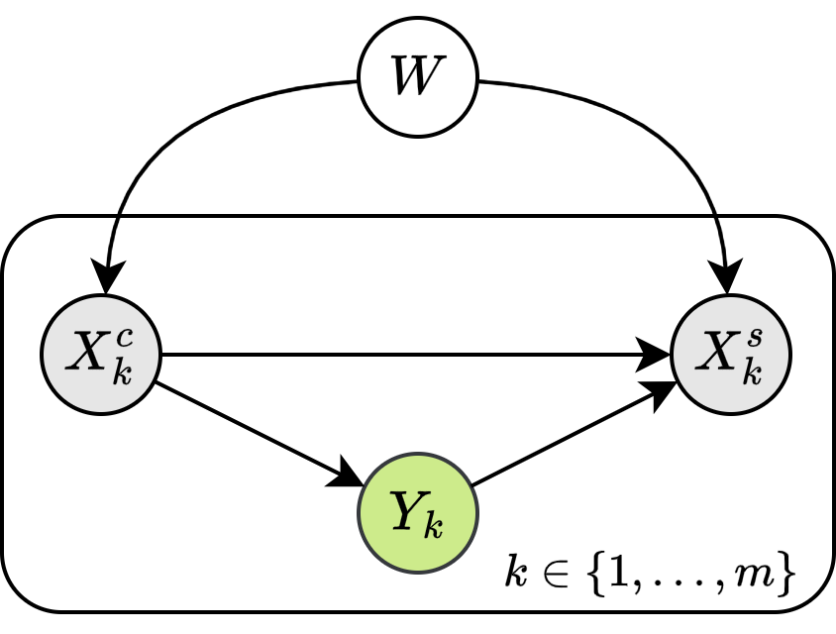
Causal Predictors are guaranteed to be robust
Notes:
In order to understand the insight from the Unsupervised Domain Adaptation problem, let’s first review why Causal Predictors are the state of the art.
I will use my diabetes example.
We want to diagnose whether a patient has type 2 diabetes.
Y is the diagnosis.
Xc is the body-mass index.
Xs is the frequency of thirst.
W is the amount of salt in the patient’s diet.
The grouping could be country or region.

Slide 12
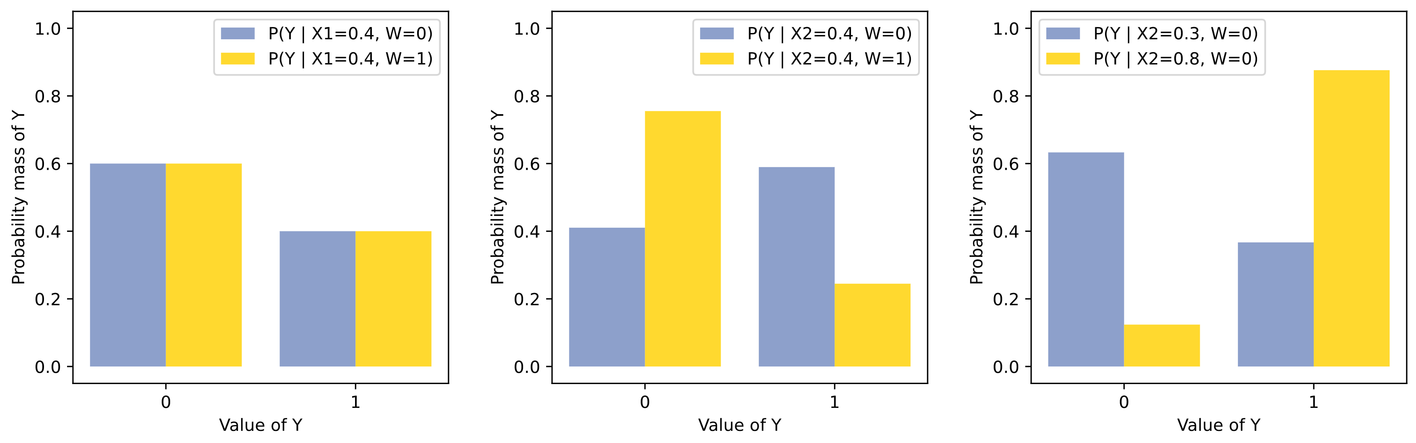
But Causal Predictors cannot use symptoms
Notes:
If we want our predictor to perform well across different countries, using the causal variable (body-mass index) is very reliable.
In the Figure to the Left we see that, even if we change the region, body-mass index is just as good a predictor of diabetes.
Across environments, the probabilities stay the same.
The Figure in the Centre shows that if we use symptoms as a predictor of diabetes, the accuracy varies wildly as a function of region.
This shows that Causal Predictors are robust to changes in environment.
#
However, this doesn’t mean that there isn’t information in the symptoms that could still be used to improve the prediction.
The Figure on the Right shows that, if we held the environment constant, symptoms are a good predictor of diabetes.
The probability of diabetes changes with a change in symptoms.

Slide 13
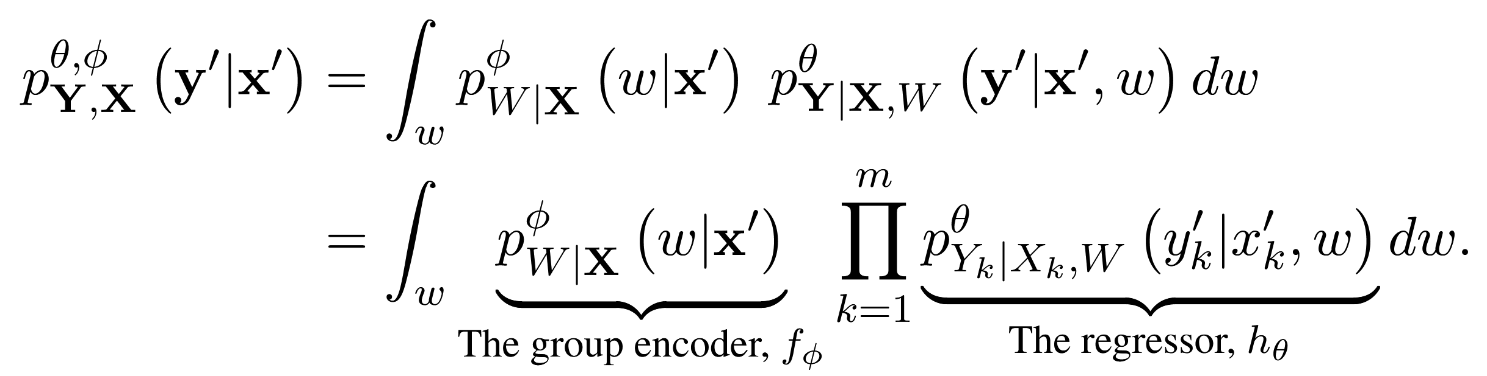
Group Predictors can use symptoms (safely)
Notes:
So, the question is, how can we make use of symptom information in a “safe” way?
The solution is to move from the paradigm of singleton predictions (predict only for one patient) to the paradigm of Group Predictions (predict jointly for all the patients in a region).
#
Here, I propose an example of a group predictor using my Group-Instance Model.
Firstly, I decompose the probability of a group of diagnoses conditioned on a group of covariates (both causes and symptoms, we don’t know which is which).
I decompose it into a per-patient prediction problem like before, but which additionally conditions on the group-level latent variable w.
That group-level latent variable is inferred at test-time from the group of observations using a Group-Instance Variational Autoencoder.
So the procedure is:
Pre-train the Group-Instance VAE on grouped data.
Train a regressor on the inferred latents extracted from the VAE.

Slide 14
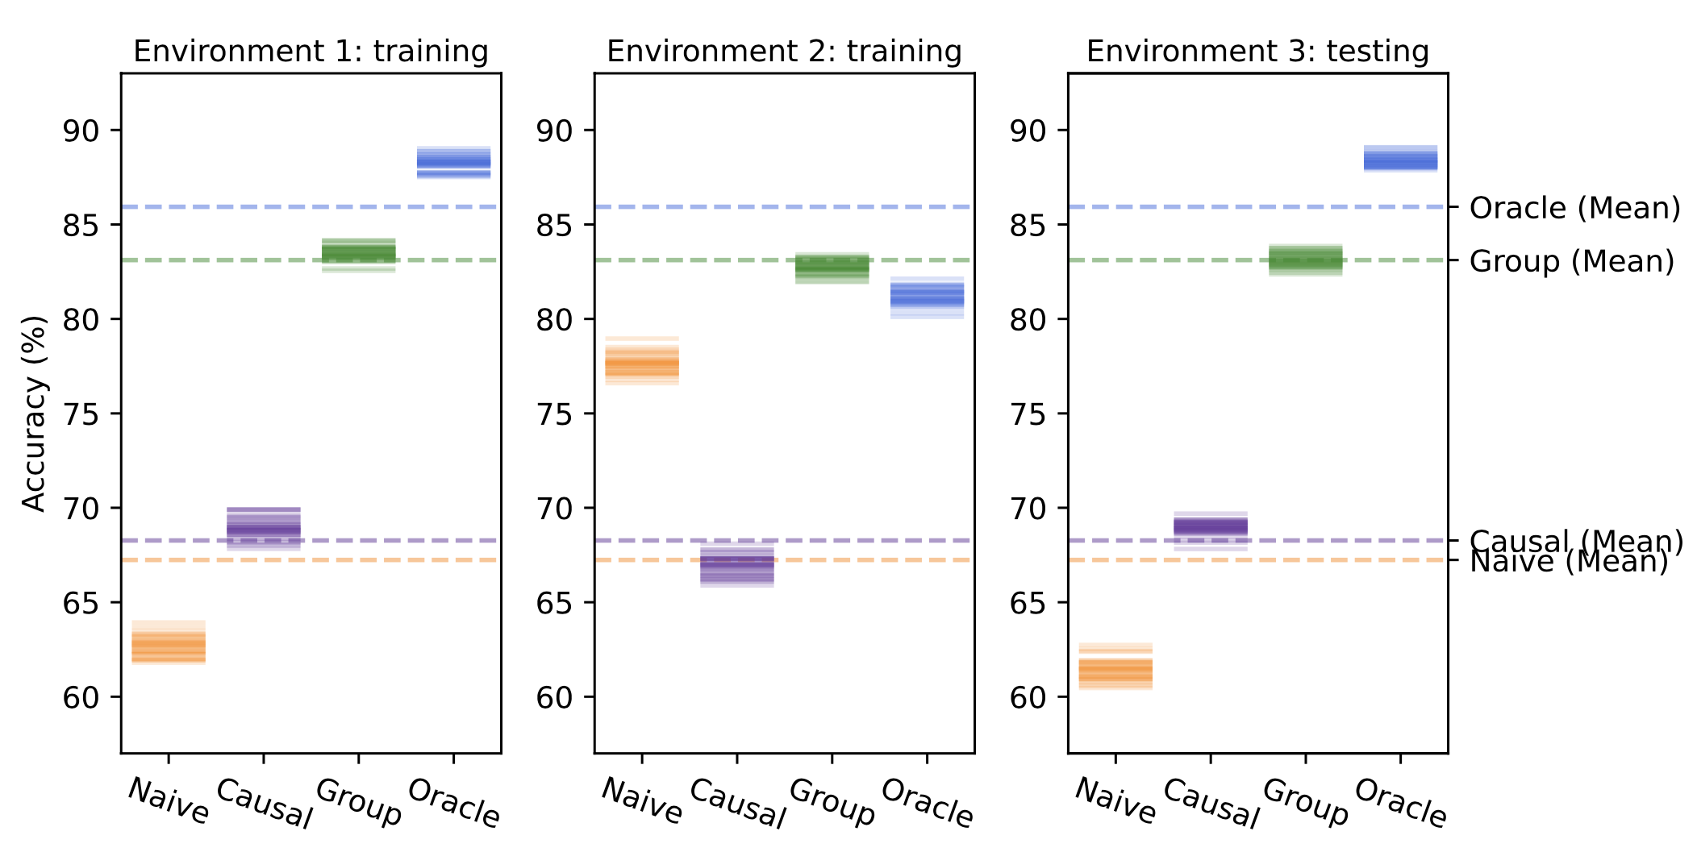
Group Predictors outperform Causal Predictors
Notes:
This procedure actually outperforms causal predictors when extrapolating to new environments.
Here we have 2 training environments and 1 held-out environment.
The Group Predictor vastly outperforms the Causal Predictor.
It even comes close to the Oracle (which is a Naïve predictor trained on the testing environment)

Slide 15
Summary
We want to train models to perform Bayesian accumulation.
However, the implementation is not straightforward.
I propose my own implementation, the Group-Instance Model, which reveals new insights for Style-Content Disentanglement and Missing Data Imputation.
The future of supervised learning are Contextual Predictions.

Slide 16
The End
Thank you!

Slide 17
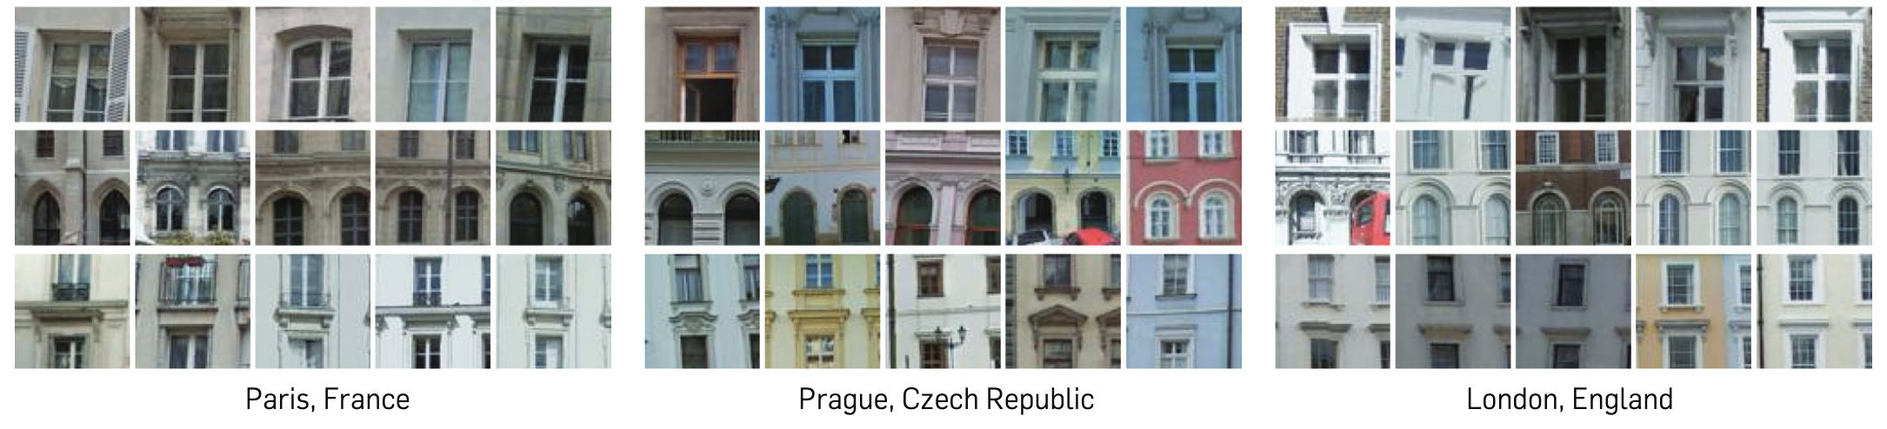
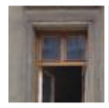
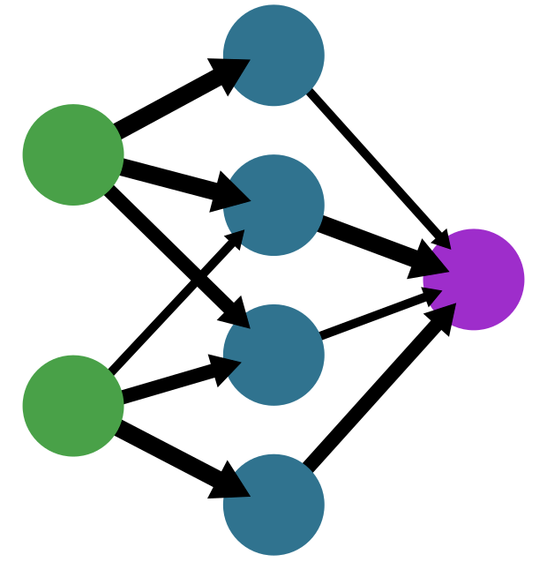
Research Question
High-dimensional data often come in groups.
But most Machine Learning methods only predict single datapoints.
Paris? Prague?
How can we aggregate information from a group of observations?
Notes:
The research question I pursued in my PhD is how to aggregate information from a group of observations?
In the real world, high-dimensional data often comes in groups.
For example, these are photos of architectural elements grouped by city. We see that each city has an overall different style.
However, most Machine Learning methods only make predictions at the individual level.
Single observations are often ambiguous. It’s hard to tell whether a single photo comes from Paris or Prague.
There is a lot of information wasted.
We will investigate how to aggregate information.

Slide 18
Case 2: Style-Content Disentanglement (Approach)
Text

Slide 19
Initial Problem: Style-Content Disentanglement
Dan Andrei Iliescu and Damon J Wischik. “Style-Content Disentanglement Under Conditional Shift”. In Data-Centric Machine Learning Workshop, International Conference on Learning Representations, 2024.

Slide 20
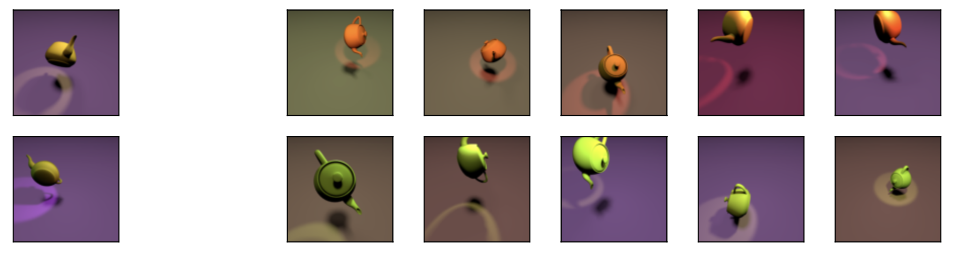
Initial Problem: Style-Content Disentanglement (Problem)

Slide 21
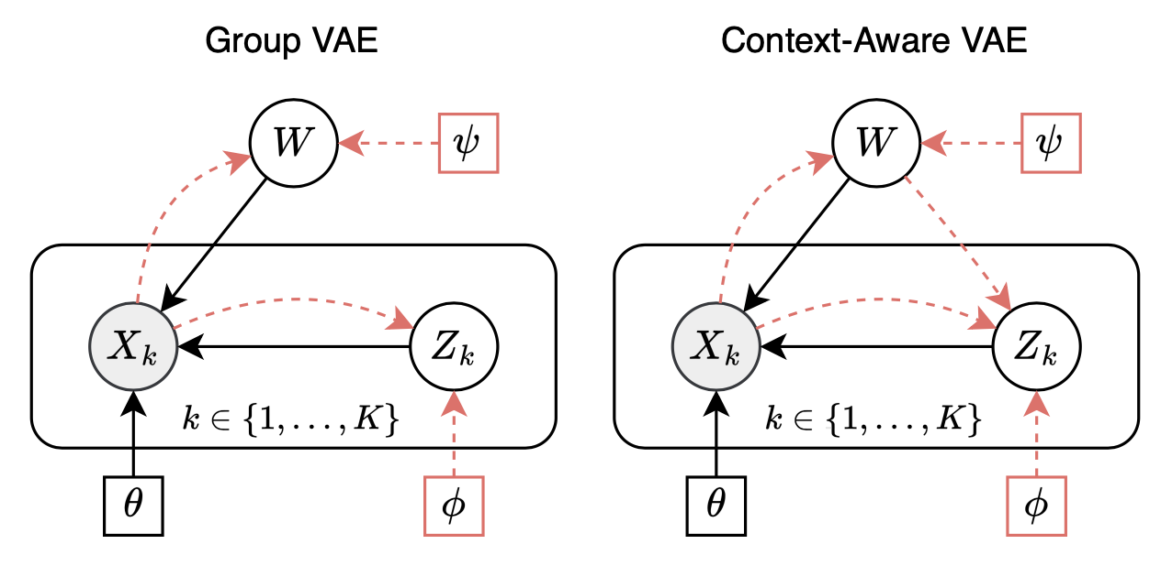
Initial Problem: Style-Content Disentanglement (Insight)

Slide 22
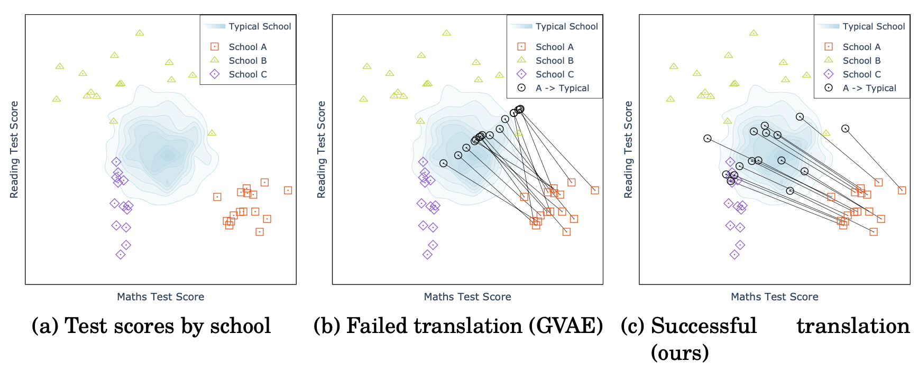
Initial Problem: Style-Content Disentanglement (Results)

Slide 23
Lateral Move: Missing Data Imputation
Dan Andrei Iliescu, Devang S Ram Mohan, Tian Huey Teh, and Zack Hodari. “Controllable Prosody Generation With Partial Inputs”. In Proceedings of IEEE International Conference on Acoustics, Speech and Signal Processing (ICASSP), 2024.

Slide 24
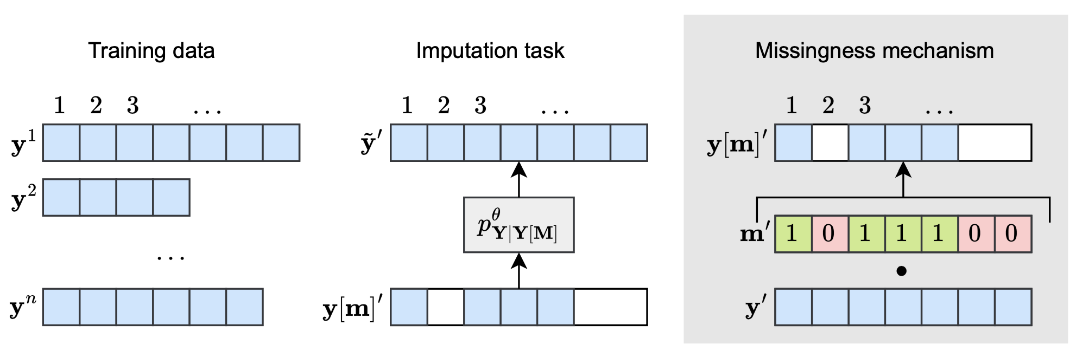
Lateral Move: Missing Data Imputation (Problem)
Notes:
The problem are missingness patterns.

Slide 25
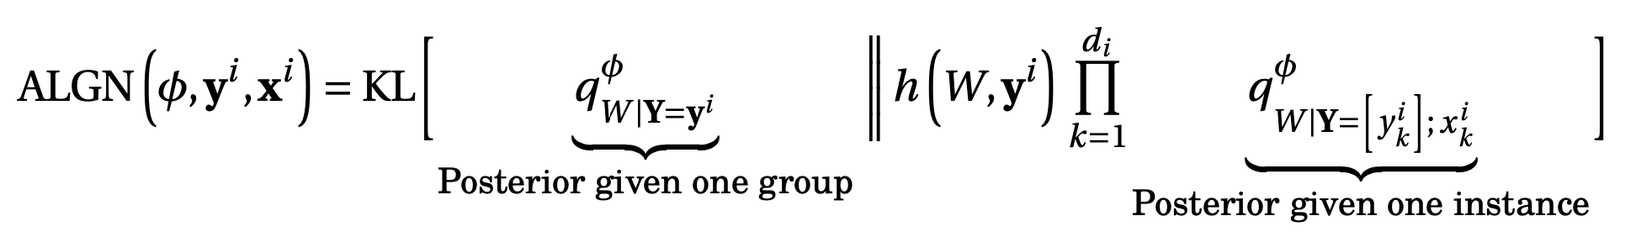
Lateral Move: Missing Data Imputation (Insight)
Notes:
The alignment loss is a regularisation term.
It encourages

Slide 26
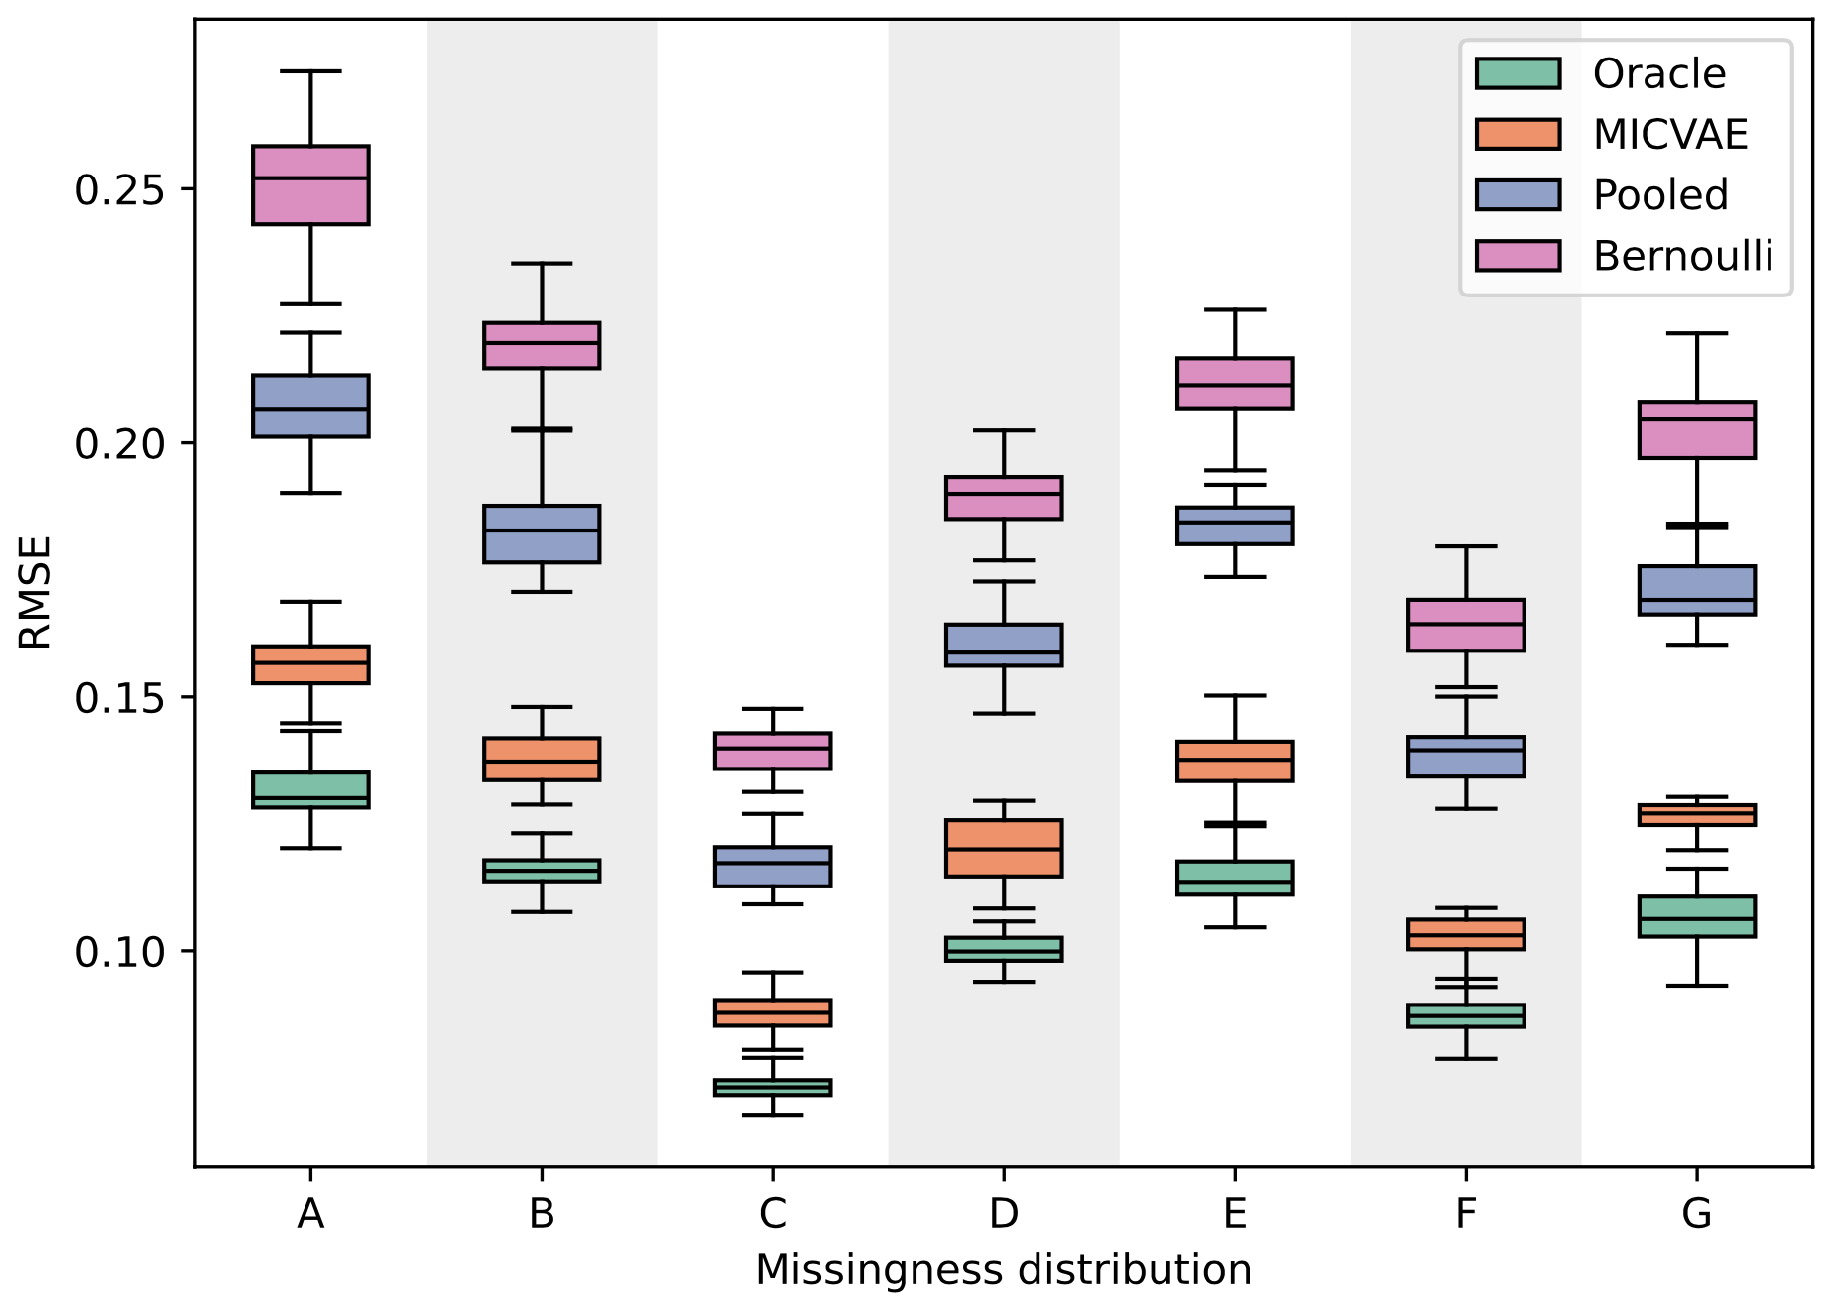
Lateral Move: Missing Data Imputation (Results)

